Slide 1
Capstone Engagement
Assessment, Analysis, and Hardening of a Vulnerable System
Written by: Eric Sexton, Jimmy Suen, Chadwick Spencer, Joe Werhan

Slide 2
Table of Contents
This document contains the following sections:
01
Network Topology
02
Red Team: Security Assessment
03
Blue Team: Log Analysis and Attack Characterization
Hardening: Proposed Alarms and Mitigation Strategies
04

Slide 3
Network Topology
‹#›

Slide 4
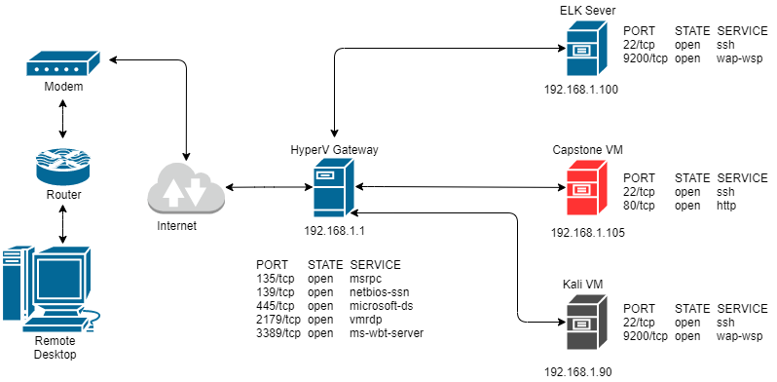
Network Topology
Network Address Range: 192.168.1.0/24 Netmask: 255.255.255.0 Gateway: 192.168.1.1
Machines IPv4: 192.168.1.90 OS: Linux Hostname: Kali
IPv4: 192.168.1.100 OS: Linux Hostname: ELK
IPv4: 192.168.1.105 OS: Linux Hostname: Capstone

Slide 5

Red Team
Security Assessment
‹#›

Slide 6
Recon: Describing the Target
Nmap identified the following hosts on the network:
Hostname | IP Address | Role on Network
Capstone | 192.168.1.105 | Target Machine
Kali Linux | 192.168.1.90 | Penetration Testing Virtual Machine
ELK Server | 192.168.1.100 | Virtual Machine for Monitoring and Logging
Gateway | 192.168.1.1 | Virtual Network with Hyper-V Manager

Slide 7
Vulnerability Assessment
The assessment uncovered the following critical vulnerabilities in the target:
Vulnerability | Description | Impact
Directory Listing Enabled on Apache Web Server | Able to read full contents of the Capstone Apache web server using a browser | Sensitive files were discovered under Ashton, the administrator for /company_folders/secret_folder
Weak Password with No Lockout for Failed Attempts | Password was easily cracked using the Hydra application and a common word list. There was no lockout for failed login attempts. | Brute force provided access to: /secret_folder/connect_to_corp_server Where instructions were stored for connecting to the webdav server
Password hash stored in text file | The administrator’s password hash was stored in a text file and was easily cracked | Cracking the hash allowed access to the WebDav service and permitted the upload of a PHP reverse shell.

Slide 8
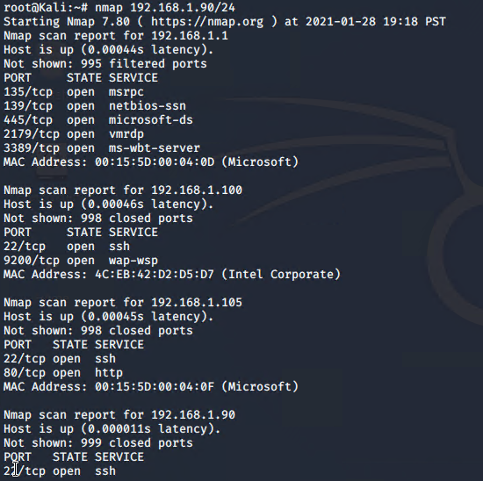
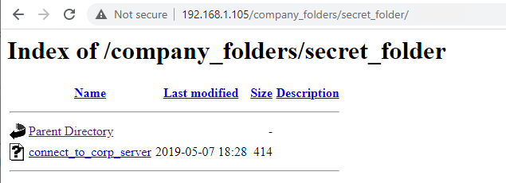
Exploitation: Directory Listing Enabled on Apache
01
02
03
Tools & Processes
Used Nmap to identify an open port 80 on 192.168.1.105
Navigated to 192.168.1.105 in a web browser and cataloged files present in the Apache Directory Listing
Achievements
Performed reconnaissance to identify directories and file locations.
Discovered Ashton is the administrator for /company_folders/secret_folder/

Slide 9

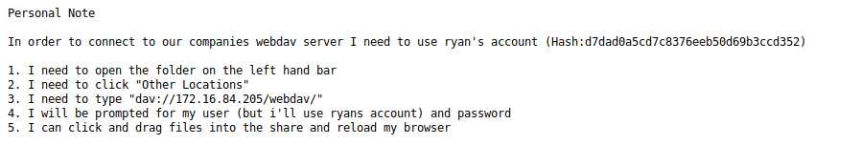
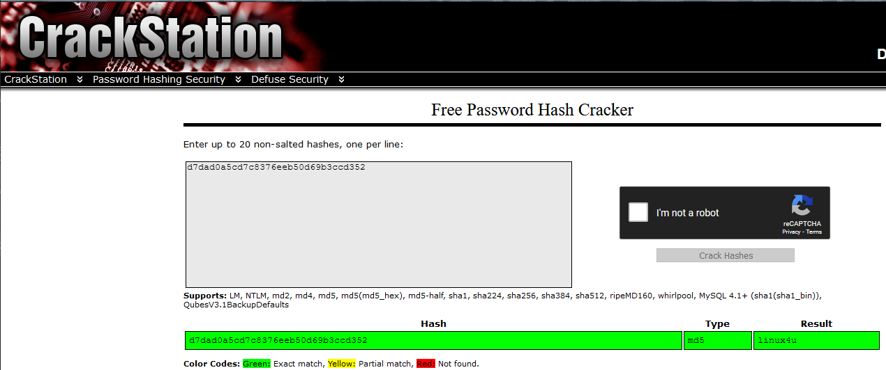
Exploitation: Weak Password & No Lockout for Failed Logins
01
02
03
Tools & Processes
Hydra was used with rockyou.txt to perform a brute force dictionary attack.
Crack Station was used to crack the site admin password hash.
Achievements
Gained password for Ashton Username: ashton Password: leopoldo
Gained access to /secret_folder/
Found the hash for Ryan’s account.
Acquired instructions for accessing /webdav/
Cracked Ryan’s hash and gained WebDav access Username: ryan Password: linux4u

Slide 10
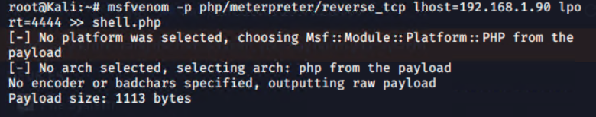
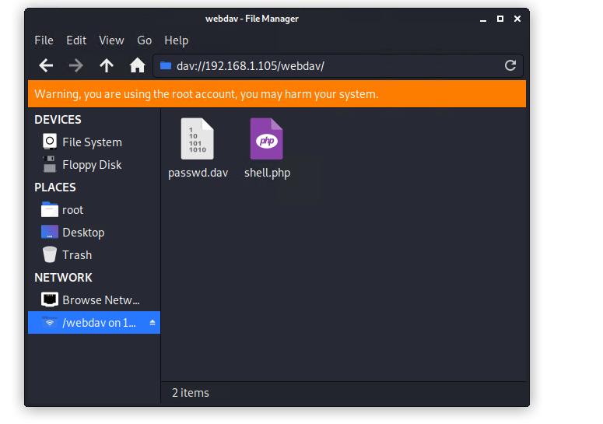
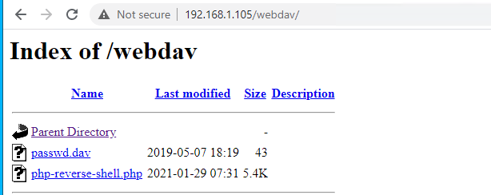

Exploitation: Persistent Reverse PHP Shell
01
02
03
Tools & Processes
Created a php reverse shell payload with msfvenom.
Logged into WebDAV using Ryan’s credentials.
Uploaded payload to the WebDAV directory.
Activated the php reverse shell payload and listened for activity with Ncat.
Activated a shell to navigate the victim
Located the flag using
find . -iname flag.txt
Achievements
Accessed the WebDAV directory.
Uploaded a persistent reverse PHP shell providing a backdoor.
Acquired access to the victim computer.
Activated the shell.
Located the flag.txt file.

Slide 11

Blue Team
Log Analysis and Attack Characterization
‹#›

Slide 12
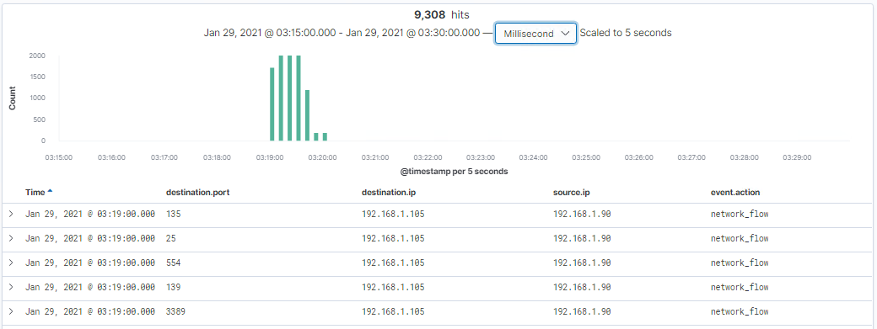
Analysis: Identifying the Port Scan
The initial port scan of 192.168.1.90 began on January 29, 2021 at 3:19:00
9,308 packets were sent from the attacking machine (192.168.1.90) to the victim machine.
The packets being sent were being directed to multiple destination ports of victim machine. If the port responds it indicates there is an open port available.

Slide 13
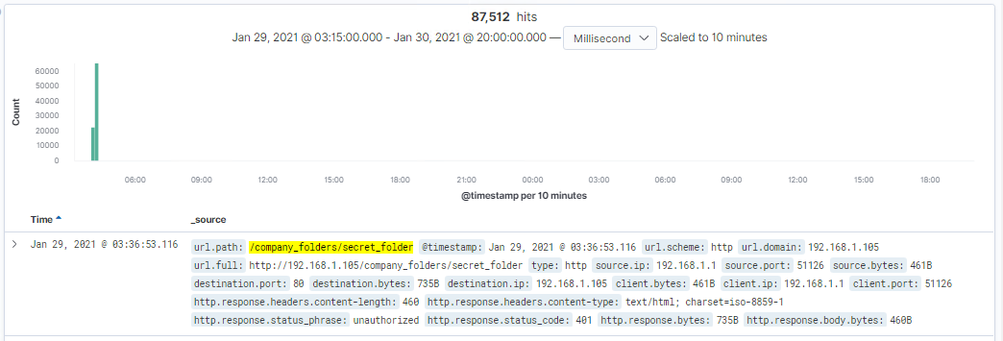
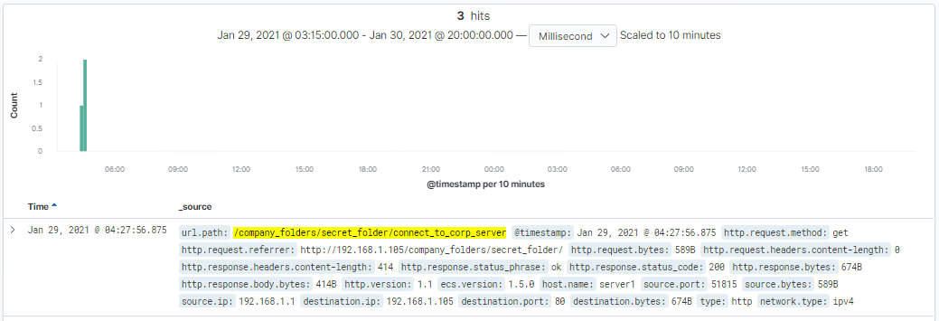
Analysis: Finding the Request for the Hidden Directory
The requests occured on January 29th 2021 at 3:36:53.
87,512 requests were made within this time period.
The connect_to_corp_server text file that contained instructions and hashed password to directly connect to the DAV corporate server.

Slide 14
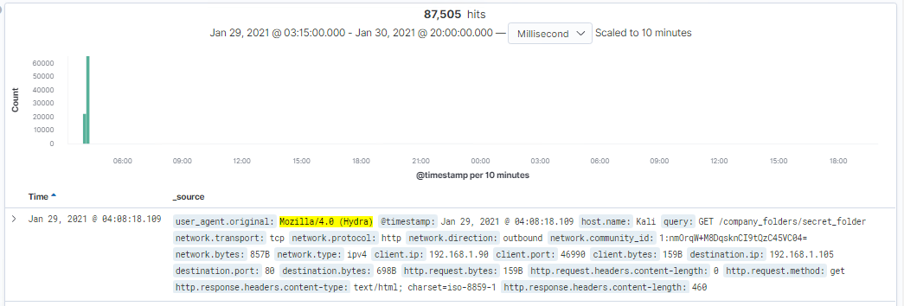
Analysis: Uncovering the Brute Force Attack
The brute force attack consisted of 87,505 attempts before the correct password was discovered.
87,504 attempts were made using Hydra, the 87,505th attempt was successful.

Slide 15
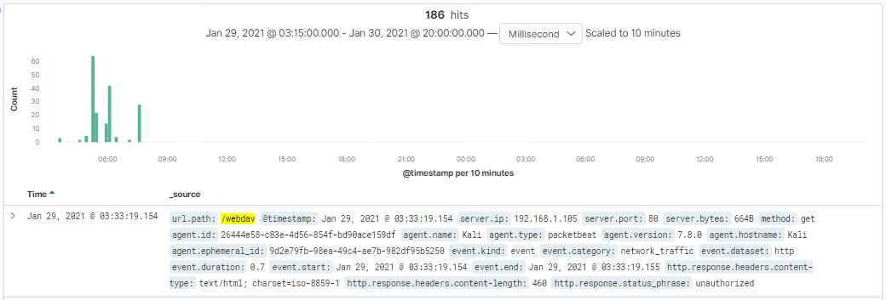
Analysis: Finding the WebDAV Connection
186 requests were made to the WebDAV directory on 01/29/2021.
The requested files were:
password.dav
php-backdoor.php
Shell.php is used to set up the listener, enabling connectivity to the network.
Password.dav file contained a username and a hashed password.

Slide 16
Blue Team
Proposed Alarms and Mitigation Strategies
‹#›

Slide 17
Mitigation: Blocking the Port Scan
The following alarm can be used to detect future port scans:
[Search] destination.ip: 192.168.1.105 and source.ip:(not 192.168.1.105) and destination.port: (not 443 or 80)
Alert to email when port 80 scans are detected more than 3 times during the same timestamp from the same recurring IP.
Port scan mitigations:
Firewall block on all incoming and outgoing ports except for those are needed (443 and 80)
Have an inline IPS for packet analysis.
Having a 24/7 IDS like Splunk or Kibana for immediate alerting of any port scan activity.

Slide 18
Mitigation: Finding the Request for the Hidden Directory
The following alarm can be used to detect future unauthorized access:
[Search] source.ip: (not 192.168.1.105 or 192.168.1.1) and url.path: *secret_folder*
Alert to email when access to the directory has more than 5 password failures, including any IPs attempting access that has not been whitelisted.
Set a timeout for 1+ hours for more than 5 password failures, with time increasing per failure.
Force password reset every 2 months.
Limit user access to the directory, and enforce multi-factor authentication.
Remove all references to the hidden directory in the webserver.

Slide 19
Mitigation: Preventing Brute Force Attacks
The following alarm can be used to detect future brute force attacks:
[Search] http.request.method : "get" and user_agent.original :"Mozilla/4.0 (Hydra)" and url.path :"/company_folders/secret_folder/"
Alert email when more than 5 Error responses (401) occur at any time or 5 (200) responses occur from non-secure IPs.
Setup account lockout rules for 5 or more failed password attempts to secure brute forcing attempts. Each failure after will increase the timer, up to 8 attempts before a administrator required unlock.
Increase password hardening requirements with a forced password reset every 2 months.
Setup multi-factor authentication for upper protected accounts.

Slide 20
Mitigation: Detecting the WebDAV Connection
Create an alert to email when non-whitelisted IPs are connecting to WebDav and whenever from non-secure locations. This alert will trigger every instance.
Limit user access to WebDav.
Password hardening authentication to WebDav(password requirements, MFA).
Upgrading to a more secure software/application.
Only allowing internal access to WebDav, within the companies building/network, while blocking all external connections.

Slide 21
Mitigation: Identifying Reverse Shell Uploads
Alert to email when “PUT” request methods are made on protected folders, from non-trusted IPs. These will automatically trigger every time.
Set up a secure anti-virus or anti-malware application that screens all incoming files and updates daily.
Limit file types that can be uploaded, including restricting php.
Update firewall rules to restrict incoming files.

